Slide 1
OpenChain Project Understanding How We Are Building A More Trusted Open Source Supply Chain

Slide 2
Please Note: These slides are designed to help the community quickly prepare talks. You can edited, remix and adjust to fit your requirements.

Slide 3
Project Overview for New People

Slide 4




Stacking Standards + Solutions
Process Management Standards
Implementation Standards
Methods

Slide 5
Trust Built By Process Management
OpenChain ISO/IEC 5230:2020 International Standard for open source license compliance.
OpenChain ISO/IEC 18974:2023 International Standard for open source security assurance.
High level process standards
Simple, effective and suitable for companies of all sizes in all markets
Openly developed by a vibrant user community and freely available to all

Slide 6
Sister Standards - Processes for Programs
ISO/IEC 5230 (License Compliance)
ISO/IEC 18974 (Security Assurance)
Flexible program size
Covering:
Inbound processes
Internal processes
Outbound processes
Standards about process points
Not about process content

Slide 7


Get Full Overviews Online
ISO/IEC 5230:2020 Open Source License Compliance
ISO/IEC 18974:2023 Open Source Security Assurance

Slide 8
ISO standards are a reputable shorthand in discussions, negotiations and contracts, allowing everything from “expected structure” to “what is a quality program” to be communicated easily. The OpenChain standards are the international baseline for quality in open source license compliance or security assurance programs.

Slide 9

We Have Community Study and Work Groups
Core Work Groups
Education (Autumn 2020~)
Specification (Spring 2016~)
Community Work Groups
Automation (Summer 2019~)
Community Study Groups
AI (January 2024~)
Industry-Specific Work Groups
Automotive (Summer 2019~)
Telecom (Spring 2021~)
Regional User Groups
China (Sept 2019~)
Germany (Jan 2020~)
India (Sept 2019~)
Japan (Dec 2017~)
Korea (Jan 2019~)
Taiwan (Sept 2019~)
UK (June 2020~)

Slide 10
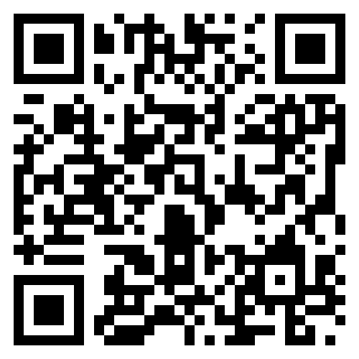
We Have Free Reference Material
The OpenChain Project has extensive reference material:
Reference open source training slides
Policy template material
Supplier education material
Self-certification checklists and questionnaires
+ many, many more documents

Slide 11
Progress Around Our Standards

Slide 12
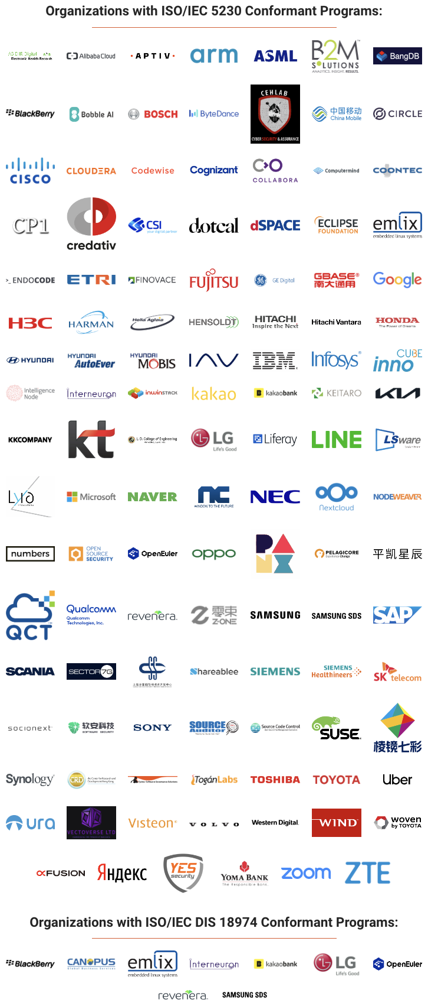



A Continual Heartbeat Of Adoption
OpenChain standards are built, used and supported by all industries
Recent adoption announcements:

Slide 13
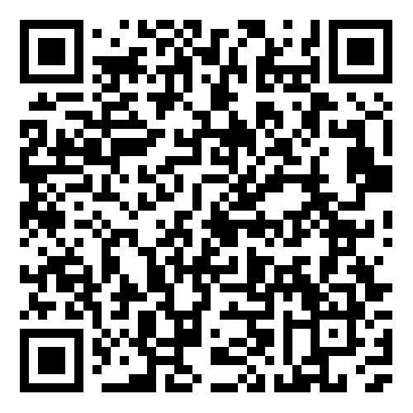
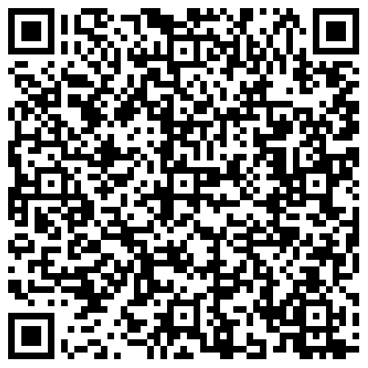
IAV Adopts ISO/IEC 5230 + Case Study Released
News
Case Study

Slide 14
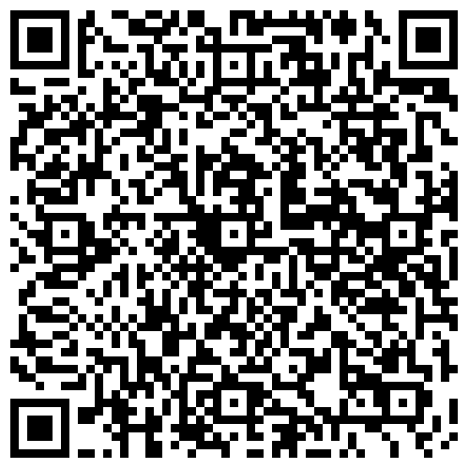
dSpace Adoption of ISO/IEC 5230

Slide 15
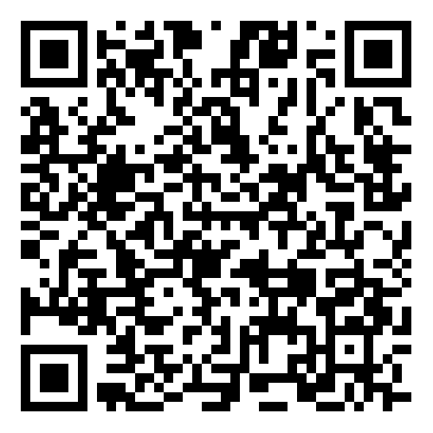
Samsung SDS Adoption of ISO/IEC 18974

Slide 16
Happening Now / Coming Soon

Slide 17


Starting 2024-06-19 ~ Ending 2024-012-19
The OpenChain Project has announced the beginning of its six month Public Comment Period for proposed draft updates to the open source license compliance (ISO/IEC 5230:2020) and open source security assurance (ISO/IEC 18974:2023) specifications.
As per our specification development process outlined in the project FAQ, this Public Comment Period will run for six months, and it will be followed by a three month Freeze Period.

Slide 18
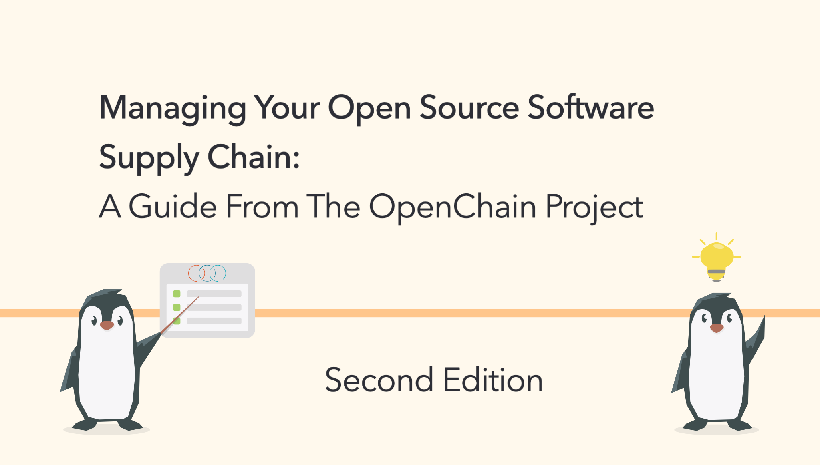
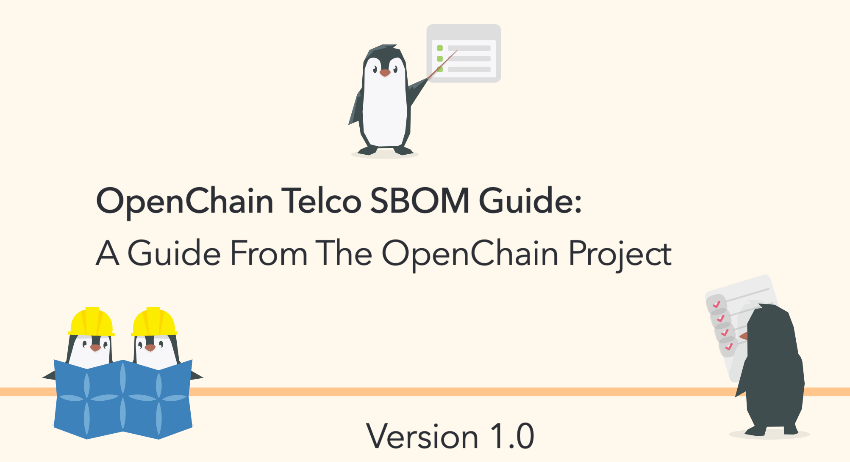


Recent Reference Material Releases

Slide 19






New AI Study Group
Workshops are held once a month discussing AI Compliance in the supply chain co-chaired by Matthew Crawford from Arm and David Marr from Qualcomm. They focus on identifying shared concerns across industries. We are considering a guide about using AI BOM in the trusted supply chain.
April
May
June
July

Slide 20

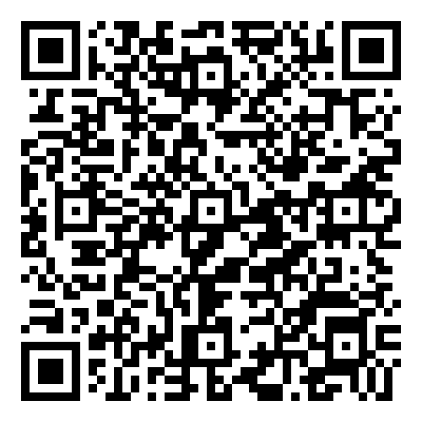
New SBOM Study Group
The OpenChain Project has required Software Bill of Materials for its standards since 2016. Over the years, we have contributed to the field by developing SPDX Lite (a simple SBOM for suppliers) and releasing a guide to define SBOM Quality. In July we launched a new monthly Study Group to bring all our various activities together and answer the question of “how do we use SBOMs in production?” Regular meetings start in September.
July

Slide 21

Reference Material Coming Soon
The OpenChain Project is developing new reference material:
Updated training slides
“Explainers” for different business roles
Maturity model for OpenChain ISO/IEC 5230

Slide 22

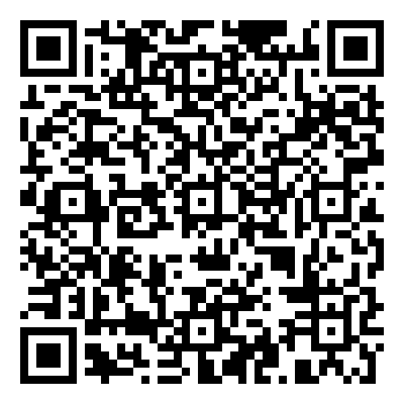
Coming in September: Automotive Workshop

Slide 23
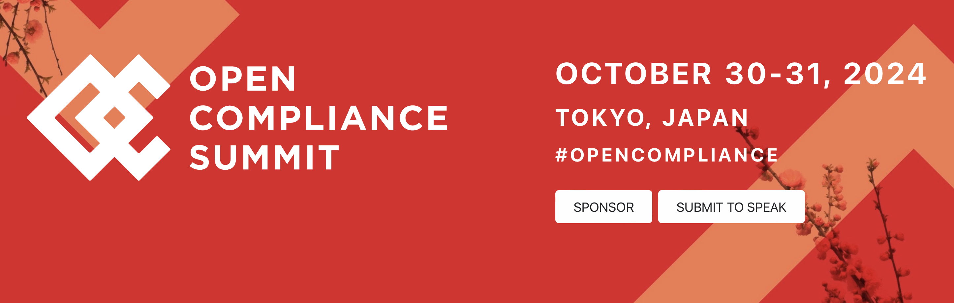
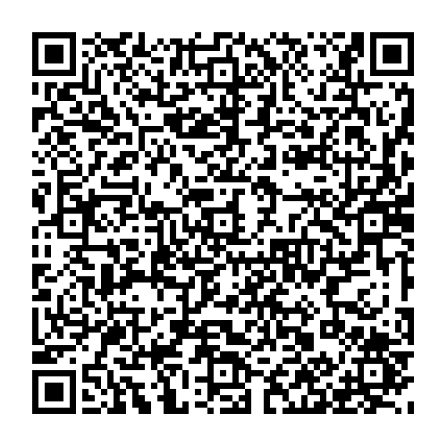
Coming in October: Open Compliance Summit

Slide 24

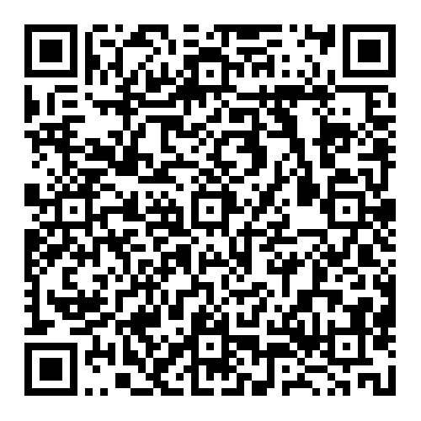
Coming in October: CC-0 Maturity Model

Slide 25
Track All This Work
Our calls are open and publicly listed.
We publish a recording of every meeting not under Chatham House Rule.
We provide access to work groups, special interest groups and local work groups via mailing list.
We also use Slack and WeChat.
All the details can be found on our participation page.

Slide 26

Thank You!
Shane Coughlan
scoughlan@linuxfoundation.org +81 80 4035 8083

Slide 27
Starting 2024-06-19 ~ Ending 2024-012-19
The OpenChain Project has announced the beginning of its six month Public Comment Period for proposed draft updates to the open source license compliance (ISO/IEC 5230:2020) and open source security assurance (ISO/IEC 18974:2023) specifications.
As per our specification development process outlined in the project FAQ, this Public Comment Period will run for six months, and it will be followed by a three month Freeze Period.

Slide 28
IAV Adopts ISO/IEC 5230 + Case Study Released
News
Case Study

Slide 29
dSpace Announces Adoption of ISO/IEC 5230

Slide 30
Samsung SDS Adoption of ISO/IEC 18974

Slide 31
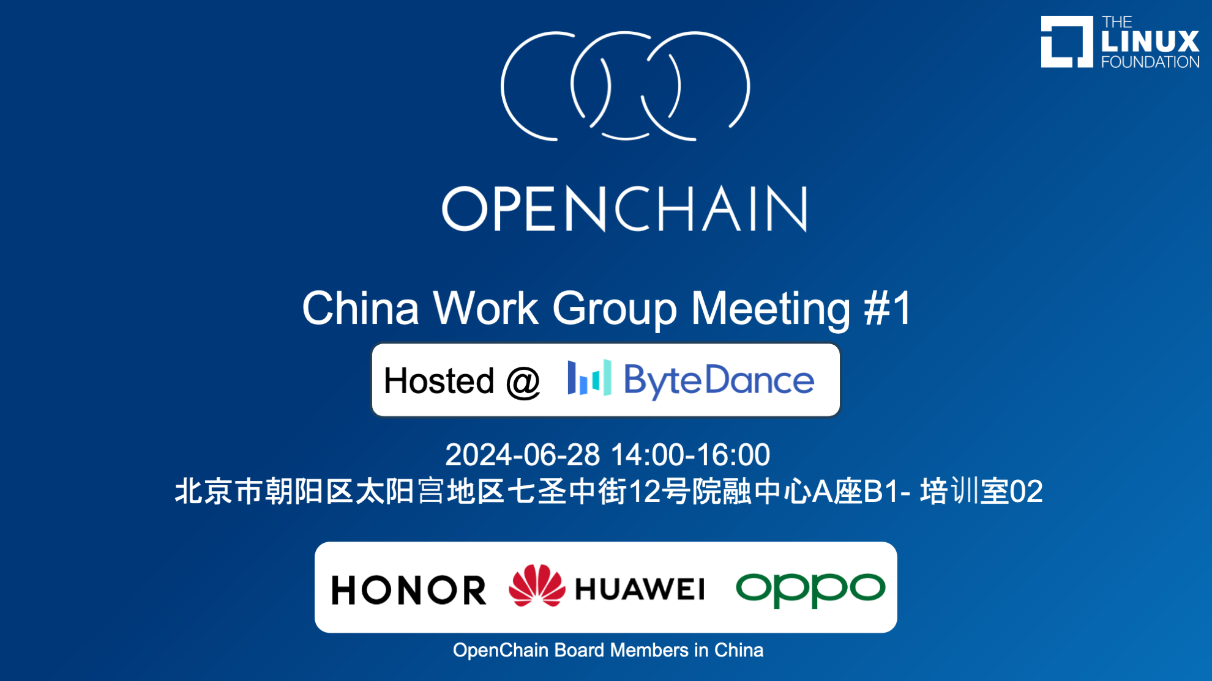
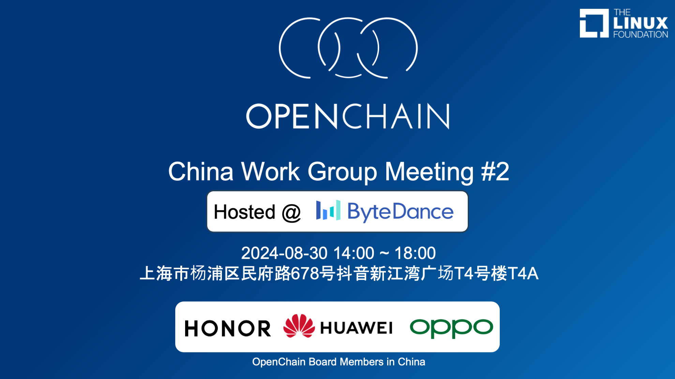
Switched to Regular Meetings in China

Slide 32
New in Q3

Slide 33
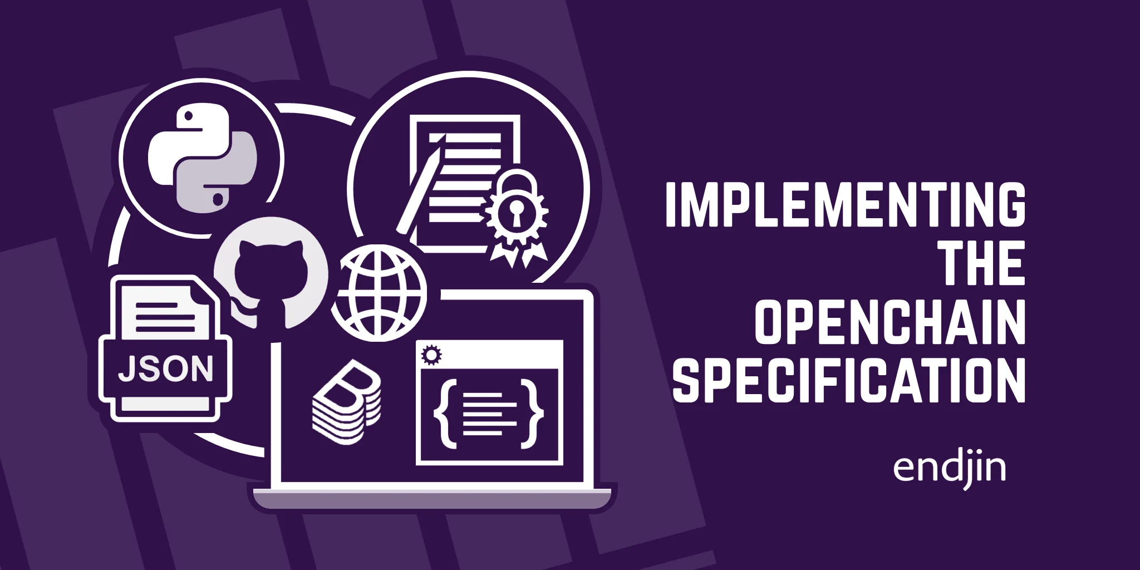
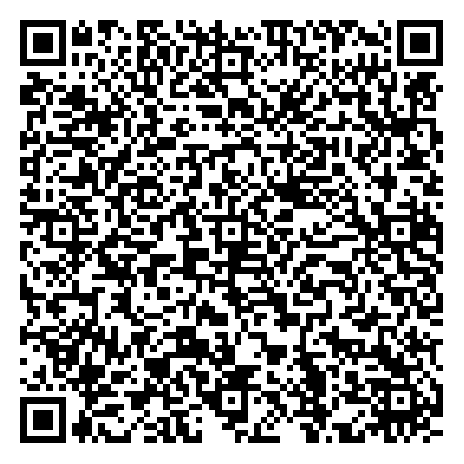
Webinar + Case Study
OpenChain ISO/IEC 5230 at endjin + Further Research on OpenChain ISO/IEC 18974

Slide 34
September: Automotive Workshop

Slide 35
October: Open Compliance Summit
Call for Papers ends on August 7th

Slide 36
October: CC-0 Maturity Model

Slide 37
AI Study Group
Workshops are held once a month discussing AI Compliance in the supply chain co-chaired by Matthew Crawford from Arm and David Marr from Qualcomm. They focus on identifying shared concerns across industries. We are considering a guide about using AI BOM in the trusted supply chain.
April
May
June
July

Slide 38
Project Overview

Slide 39
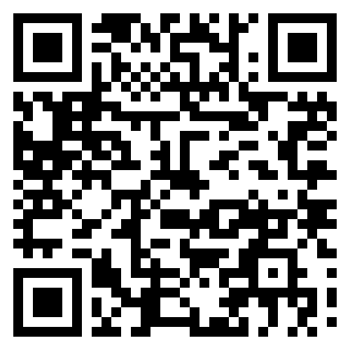
31%
Data Point
of large German companies already use or plan to adopt OpenChain ISO/IEC 5230
Source PwC: https://tinyurl.com/openchain-germany-31

Slide 40
A Continual Heartbeat Of Adoption
OpenChain standards are built, used and supported by all industries
Example adoption announcements in July:

Slide 41


A Continual Heartbeat Of Use
Companies announcing re-certification helps to boost perception of continued industry value.
BlackBerry - public announcement in April
SocioNext - public announcement in May
Nanjing Fujitsu Nanda Software Technology Co., Ltd informed us of their re-certification in February.
Reminder: ISO standards can be adopted and used by any party, so we only get informed and do PR on a discretionary basis.

Slide 42
Adoption Methods

Slide 43
How Are OpenChain Standards Adopted?
There are several mechanisms for the adoption of OpenChain Standards
The most common way is self-certification
Another way is third-party certification

Slide 44
Self-Certification – Rationale and Effectiveness
Self-certification to an OpenChain standard (and any other standard) involves an entity reviewing material, deciding that they meet the requirements it describes, and then advertising that fact.
OpenChain provides extensive resources to help with this, such as self-certification checklists.
The OpenChain standards are explicitly designed to work effectively with self-certification because:
They require a company to keep records of how they certified and details of each point (verification materials)
And OpenChain standards are designed for supply chain procurement, with an expectation that customer companies can and will audit supplier company verification materials at the time of their choosing
This has proven extraordinarily effective, and no purposeful attempts to “cheat” have been reported to us since our public launch in 2016.

Slide 45
Third-Party Certification – Rationale
Third-party certification to an OpenChain standard (and any other standard) one legal entity with appropriate permission in the local jurisdiction to certify that another legal entity meets the requirements of the relevant standard.
This is a common approach in regulation-heavy industries such as automotive around standards such as ISO 26262 (functional safety).
Because OpenChain produces ISO standards, it supports and follows the same type of third-party certification processes used by other ISO standards.
Third-party certifiers such as Bureau Veritas and PwC support OpenChain standards.

Slide 46
Support Network

Slide 47
OpenChain Study and Work Groups
Core Work Groups
Education (Autumn 2020~)
Specification (Spring 2016~)
Community Work Groups
Automation (Summer 2019~)
Community Study Groups
AI (January 2024~)
Industry-Specific Work Groups
Automotive (Summer 2019~)
Telecom (Spring 2021~)
Regional User Groups
China (Sept 2019~)
Germany (Jan 2020~)
India (Sept 2019~)
Japan (Dec 2017~)
Korea (Jan 2019~)
Taiwan (Sept 2019~)
UK (June 2020~)

Slide 48

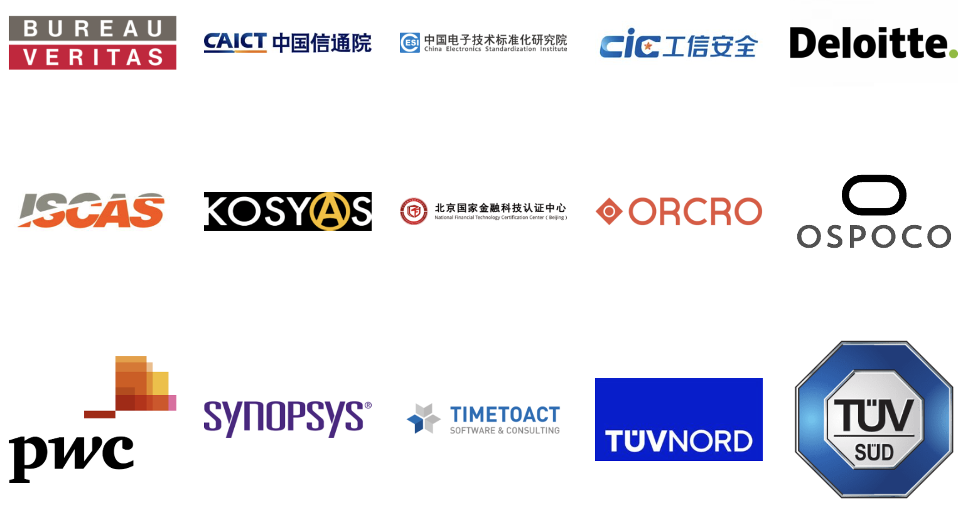
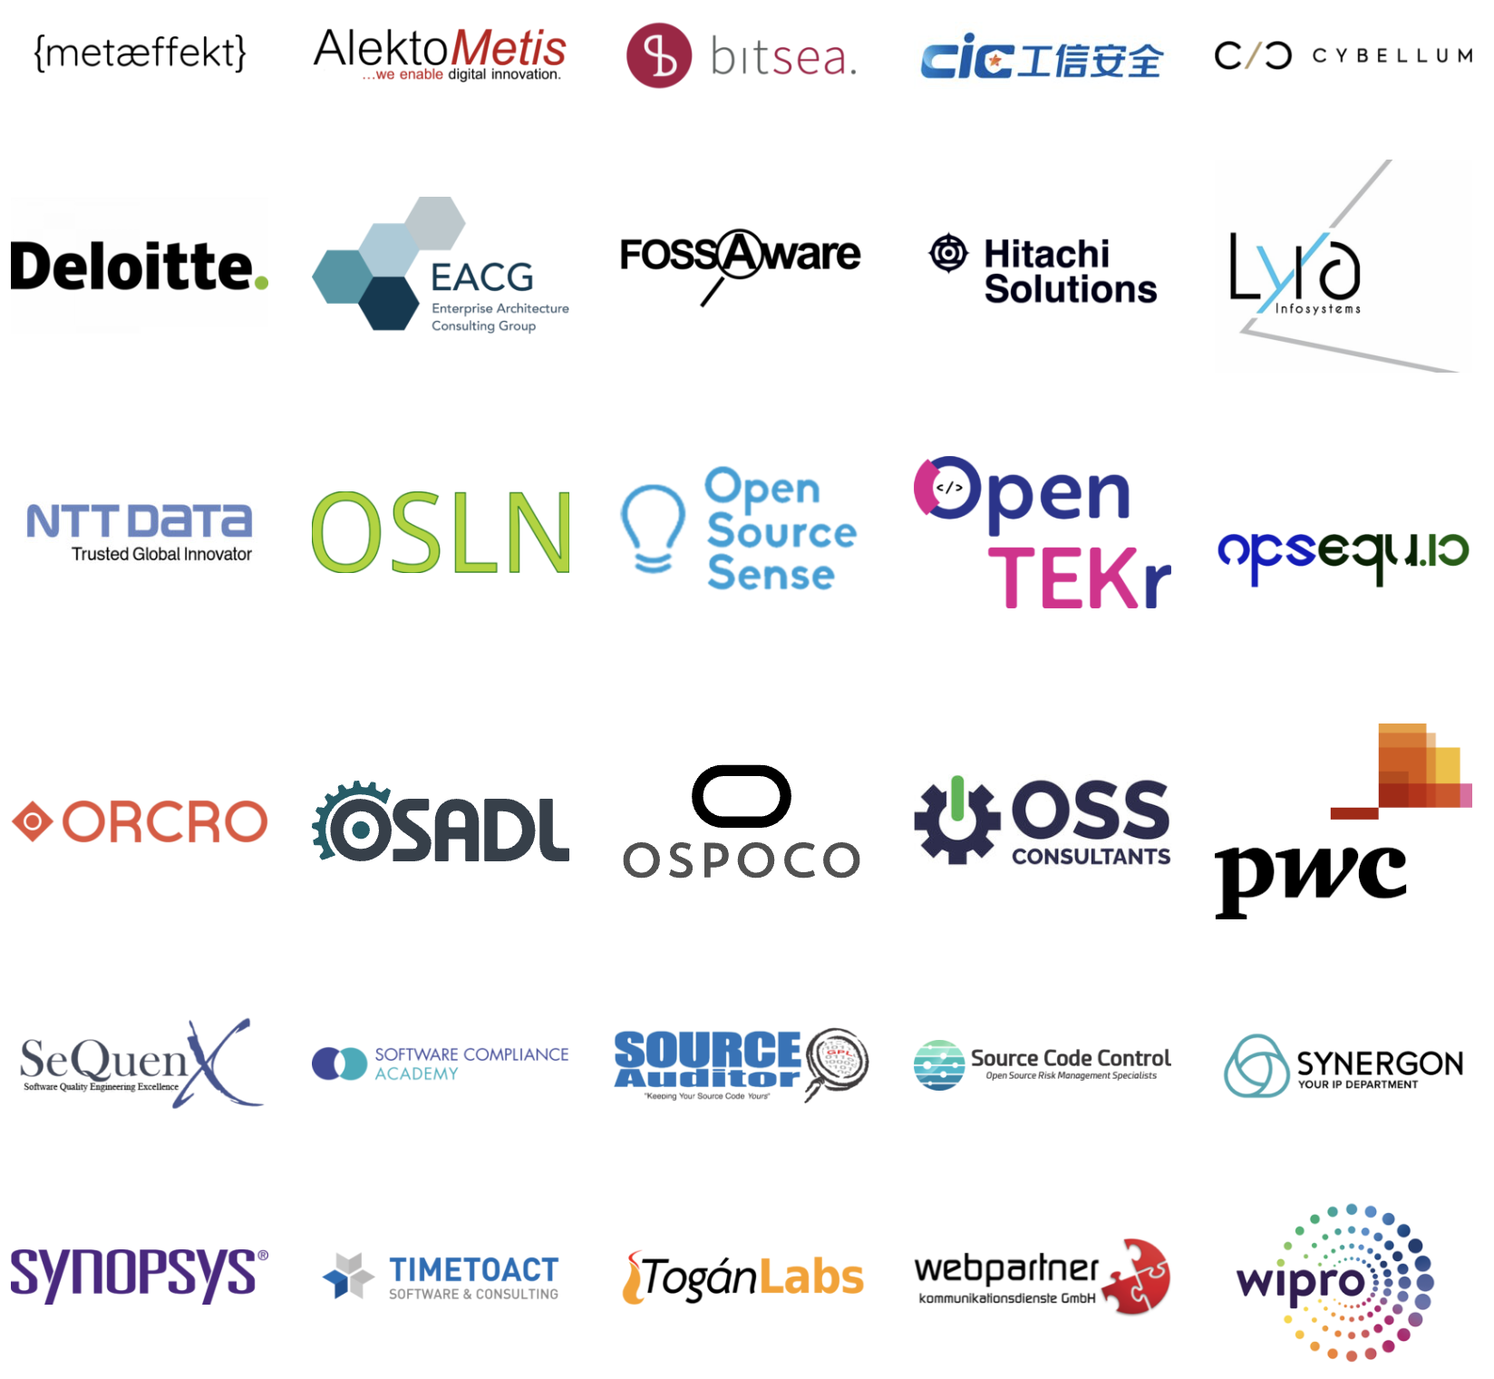
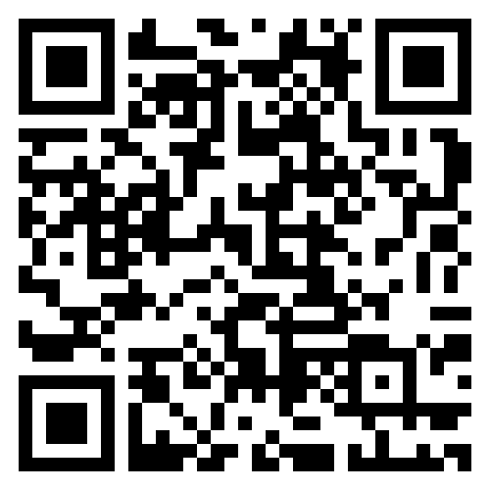
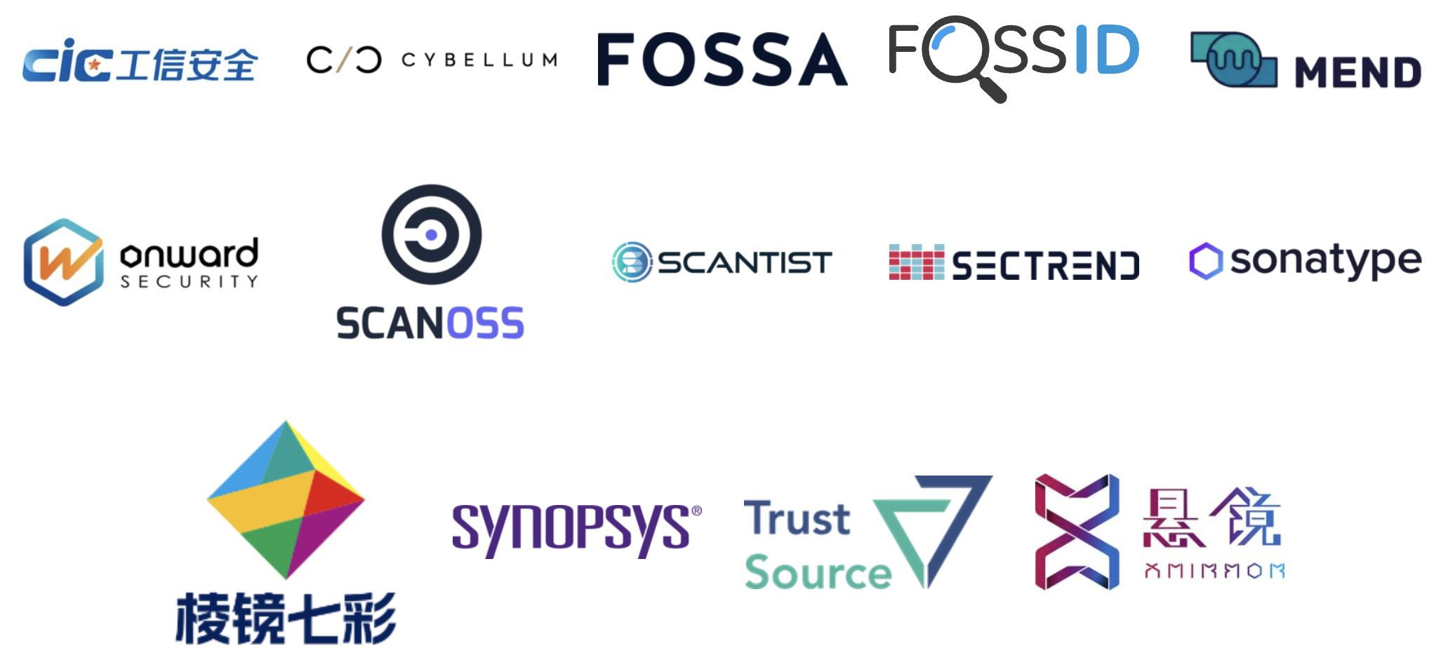
Commercial Support
Legal Providers
Third-Party Certification
Consultancies
Tooling / Automation

Slide 49
Relationship With Other Standards

Slide 50
Wide Compatibility
OpenChain standards are compatible with all compliance standards, security standards and SBOM formats that we are aware of.
In general, OpenChain standards are designed to work with all other standards related to open source process management or solution implementation.
The goal is to be practical and useful for companies of all sizes and in all markets.

Slide 51
Market Evolution

Slide 52
Procurement Negotiations
ISO/IEC 5230 and ISO/IEC 18974 are a simple “ask” for procurement in all industries.
In the 2024/2025 period we expect:
More use of industry standards versus custom approaches for procurement
More use of OpenChain standards

Slide 53
Mergers and Acquisitions
ISO/IEC 5230 and ISO/IEC 18974 are a “floor” to check risk management in M&A.
In the 2024/2025 period we expect:
More use of OpenChain standards for M&A
More case studies around the use of OpenChain standards

Slide 54
Supply Chain Management
ISO/IEC 5230 and ISO/IEC 18974 make it easy for customers to check open source license compliance and security assurance.
In the 2024/2025 period we expect:
More supply chain requests for OpenChain use
Open source maturity models describing OpenChain standards

Slide 55
What About Regulation?

Slide 56
Addressing US Executive Order / NIST / CISA
OpenChain ISO/IEC 5230 and ISO/IEC 18974 require the use of SBOMs.
They are flexible enough to meet any specific requirements the US develops around SBOM use, structure or format.

Slide 57
Addressing the CRA
OpenChain ISO/IEC 5230 and ISO/IEC 18974 asked for record-keeping before Cyber Resiliency Act (CRA) made it into a requirement.
OpenChain ISO/IEC 5230 and ISO/IEC 18974 require companies to create and archive verification materials around open source license compliance and security assurance.

Slide 58
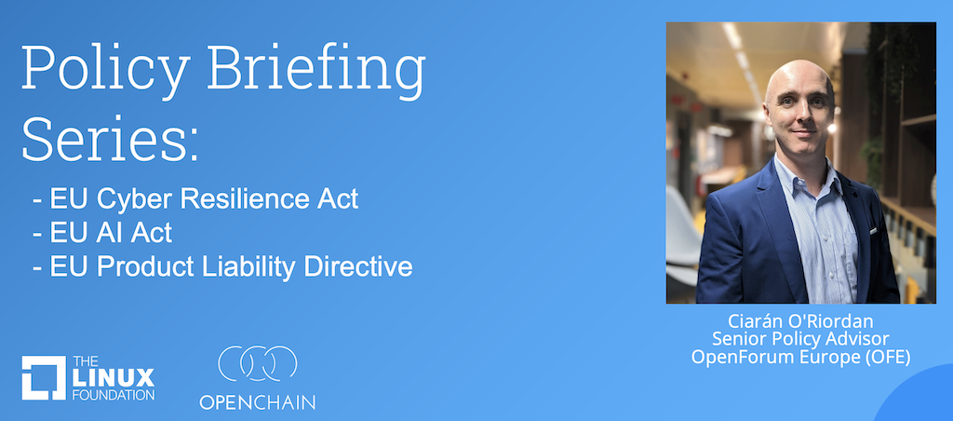
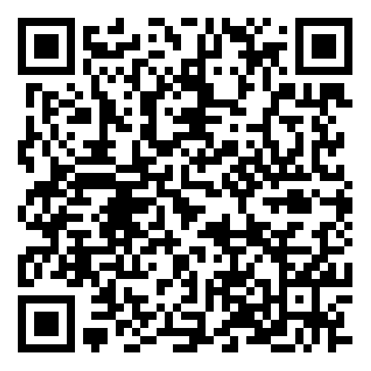
Policy and Regulation Webinar Series:

Slide 59
Reference Material

Slide 60
Existing Reference Material
The OpenChain Project has extensive reference material:
Reference open source training slides
Policy template material
Supplier education material
Self-certification checklists and questionnaires
+ many, many more documents

Slide 61
New in July

Slide 62


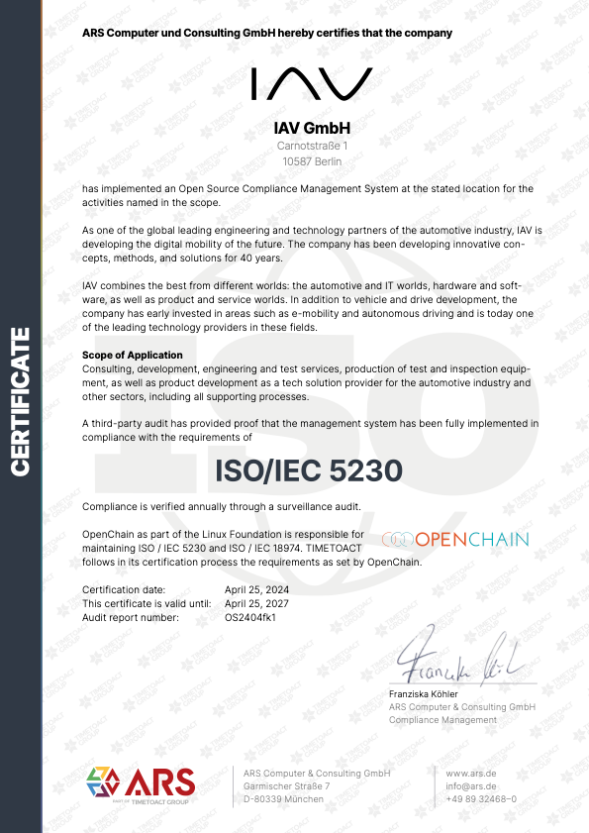


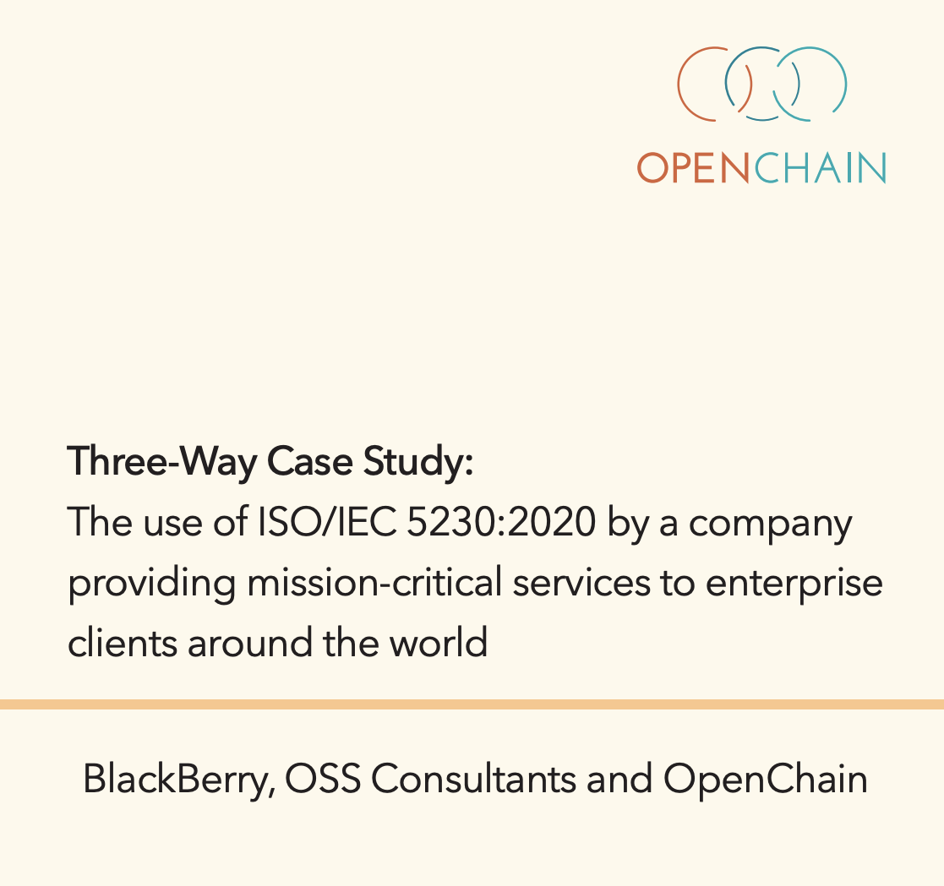
Case Studies

Slide 63
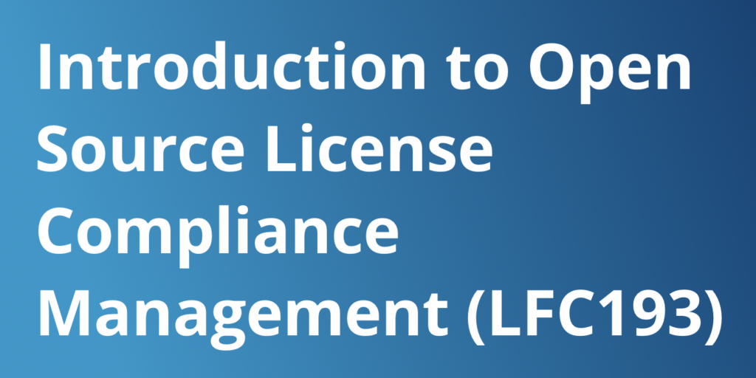
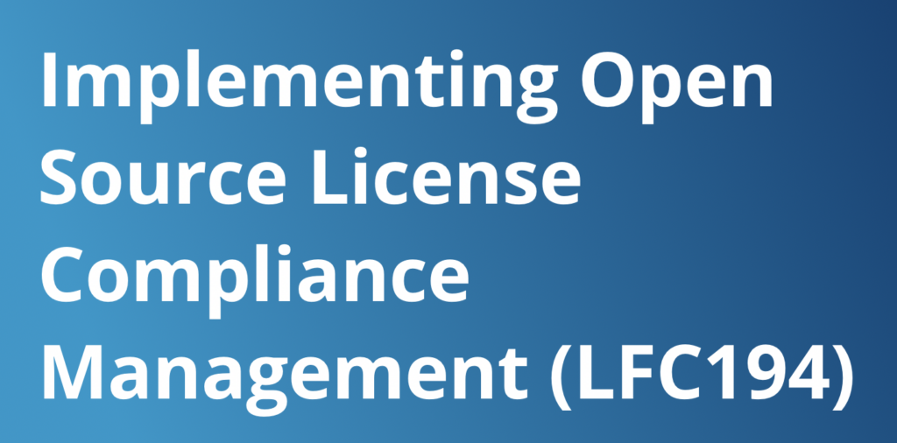
Training Courses

Slide 64

90+
Data Point
Webinars covering all aspects of open source management and governance
https://openchainproject.org/webinars

Slide 65
Forthcoming Reference Material
The OpenChain Project is developing new reference material:
Updated training slides
“Explainers” for different business roles
Maturity model for OpenChain ISO/IEC 5230

Slide 66
Always Evolving

Slide 67
Starting 2024-06-19 ~ Ending 2024-012-19
The OpenChain Project has announced the beginning of its six month Public Comment Period for proposed draft updates to the open source license compliance (ISO/IEC 5230:2020) and open source security assurance (ISO/IEC 18974:2023) specifications.
As per our specification development process outlined in the project FAQ, this Public Comment Period will run for six months, and it will be followed by a three month Freeze Period.

Slide 68
AI Study Group
Workshops are held once a month discussing AI Compliance in the supply chain co-chaired by Matthew Crawford from Arm and David Marr from Qualcomm. They focus on identifying shared concerns across industries. We are considering a guide about using AI BOM in the trusted supply chain.
April
May
June
July

Slide 69
In Conclusion

Slide 70
What Is Happening Right Now?
An increase in the use of formal standards around open source
An increase in the use of OpenChain standards for licensing and security
Improved trust in the supply chain because of this
In 2024/2025 the OpenChain Project expects awareness and capability around open source standards to become critical for companies.

Slide 71
What Is Coming Next For The Market?
There is a steady, inevitable trend:
Open source is becoming more professional
Open source is becoming more accountable
Open source is becoming more sustainable
In 2024/2025 the OpenChain Project expects this trend to bring open source closer to traditional Software Asset Management (SAM).

Slide 72
What Will The OpenChain Project Do?
We will continue to assist in the professionalization of the supply chain, with specific impact in procurement, M&A and supply chain management
We will continue to grow our reference library of material to assist companies adopting and using our standards.
We will also support process management discussions in new domains like AI Compliance

Slide 73
Let’s Talk More
Shane Coughlan
scoughlan@linuxfoundation.org +81 80 4035 8083

